Slide 1

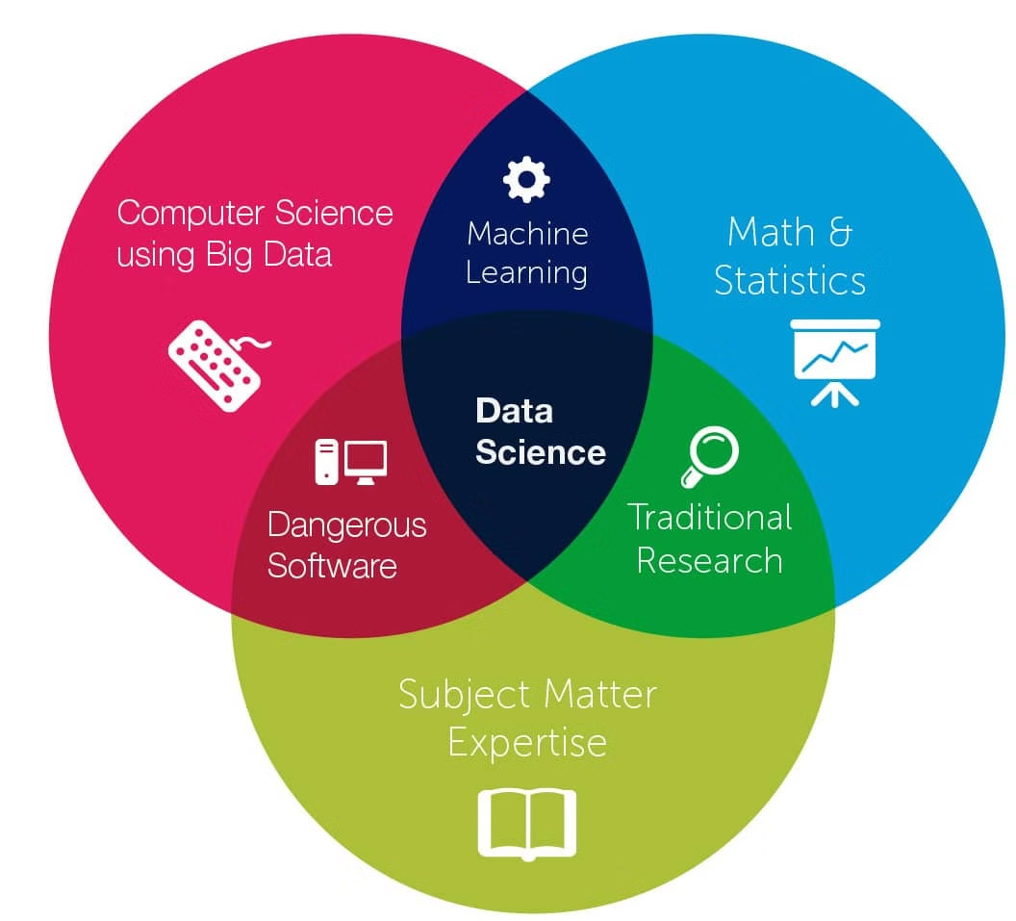
Data Science and Big Data: Unlocking the Future
Data science and big data are transforming the way businesses and organizations operate. Leveraging advanced analytics, machine learning, and vast data sources, data science provides powerful insights to drive innovation and strategic decision-making.
L. SaiSri - 22071A6791

Slide 2
Understanding the Fundamentals of Data Science
Data Collection
Data Preprocessing
Statistical Analysis
Gathering and curating data from diverse sources, including structured, unstructured, and real-time data.
Cleaning, transforming, and preparing data for analysis to ensure accuracy and relevance.
Applying statistical techniques to uncover patterns, trends, and insights hidden within the data.

Slide 3


The Role of Big Data in Data Science
1
Data Volume
Handling and processing large, complex datasets that cannot be managed with traditional tools.
2
Data Variety
Integrating and analyzing structured, unstructured, and real- time data from multiple sources.
3
Data Velocity
Rapidly analyzing and deriving insights from data that is constantly being generated and updated.

Slide 4

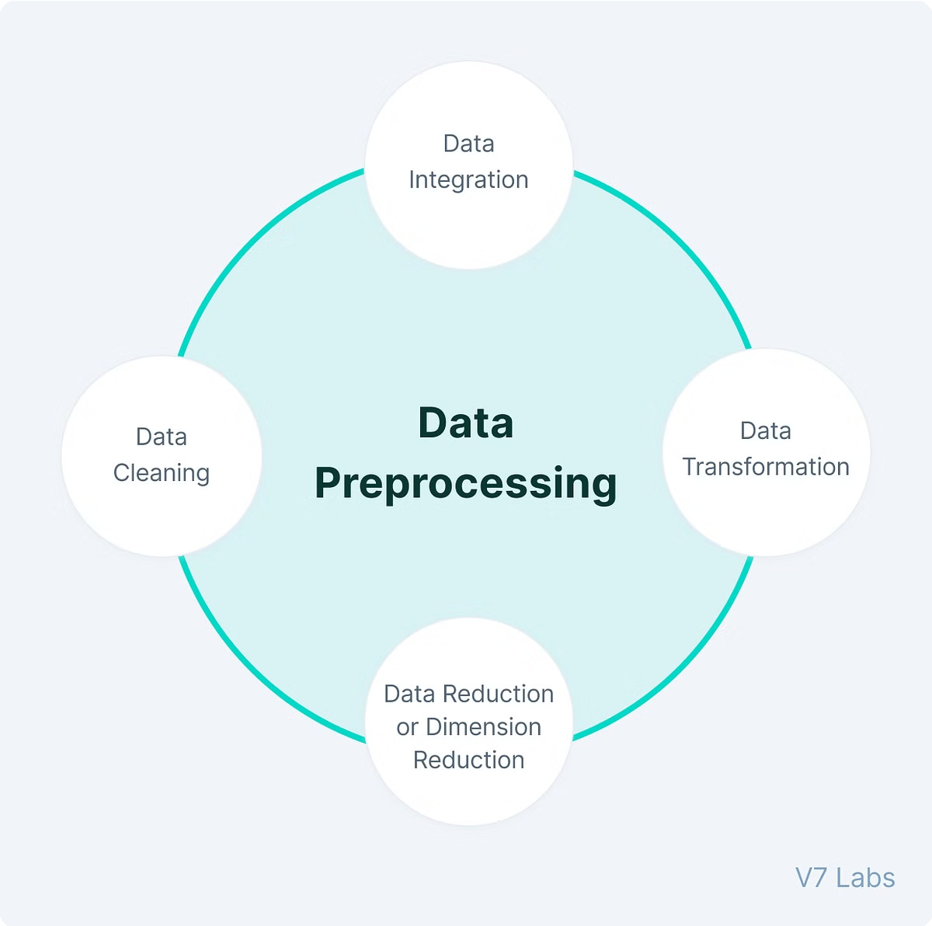
Data Collection and
Preprocessing Techniques
Data Extraction
Gathering data from various sources, including databases, APIs, and web scraping.
Data Cleaning
Identifying and addressing missing values, outliers, and inconsistencies in the data.
Data Transformation
Data Integration
Converting data into a standardized format for efficient analysis and modeling.
Combining multiple datasets from different sources to create a comprehensive data repository.

Slide 5
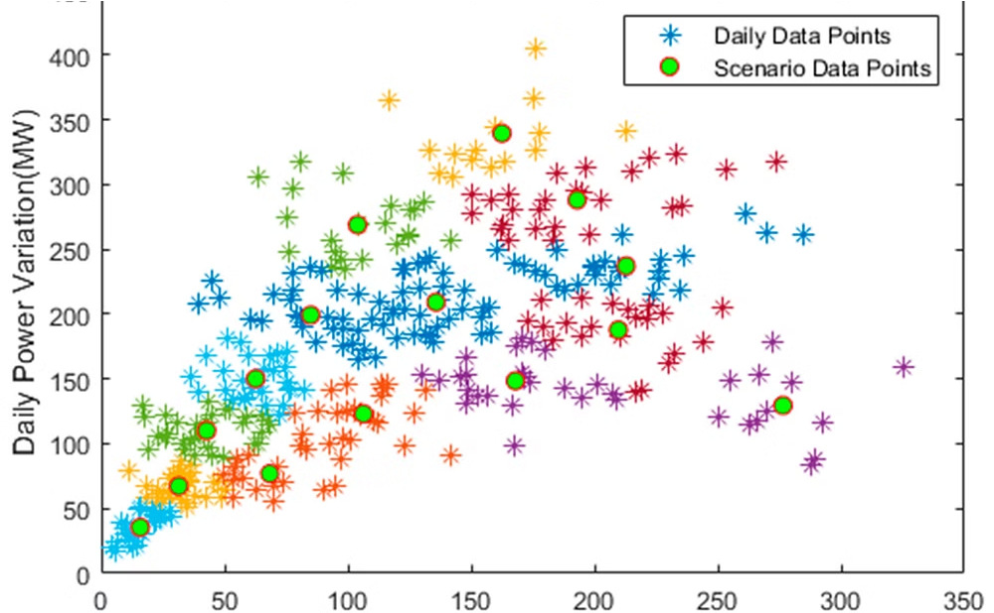
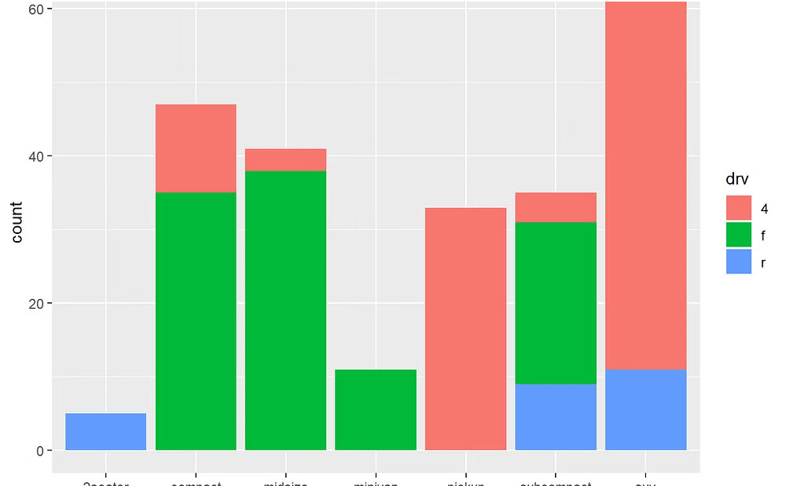
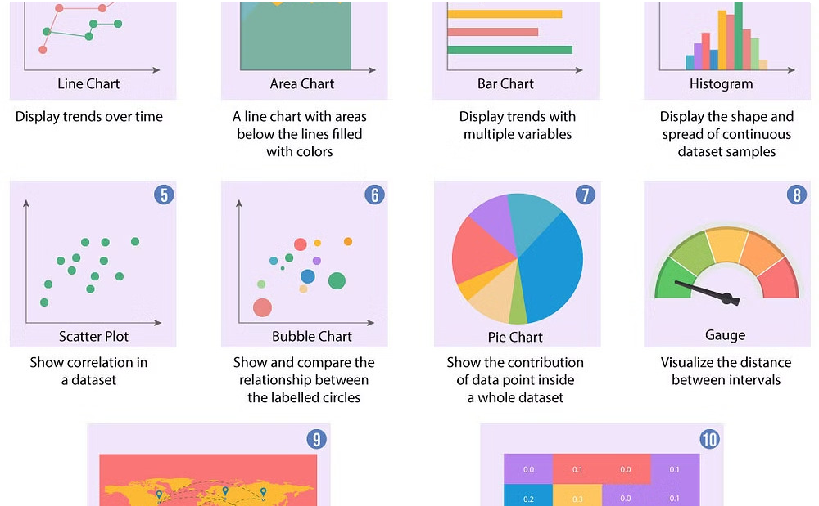
Data Visualization and Exploratory Data Analysis
Scatter Plots
Bar Charts
Line Charts
Visualizing the relationship between two variables to identify patterns and outliers.
Displaying and comparing categorical data to uncover trends and distributions.
Tracking changes in continuous data over time to identify trends and patterns.

Slide 6

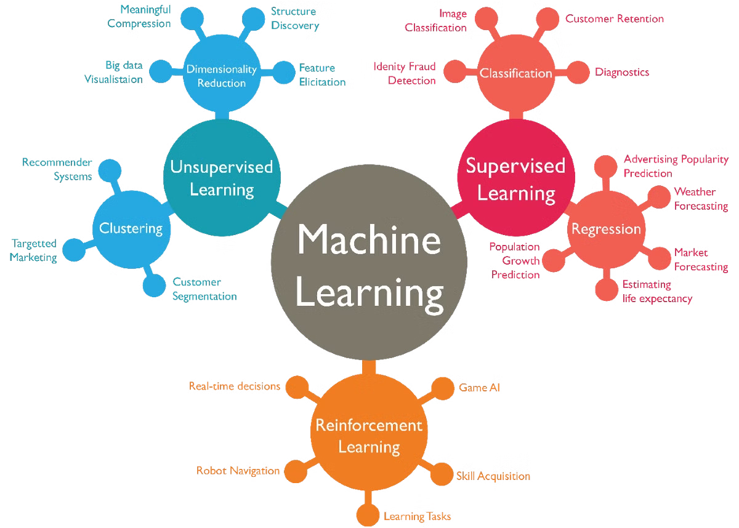
Machine Learning Algorithms and Techniques
Regression
Predicting continuous target variables based on one or more input features.
Classification
Assigning data to discrete categories or classes based on its characteristics.
Clustering
Grouping similar data points together to uncover hidden patterns and structures.
Decision Trees
Building predictive models that
make decisions based on a series of rules.

Slide 7

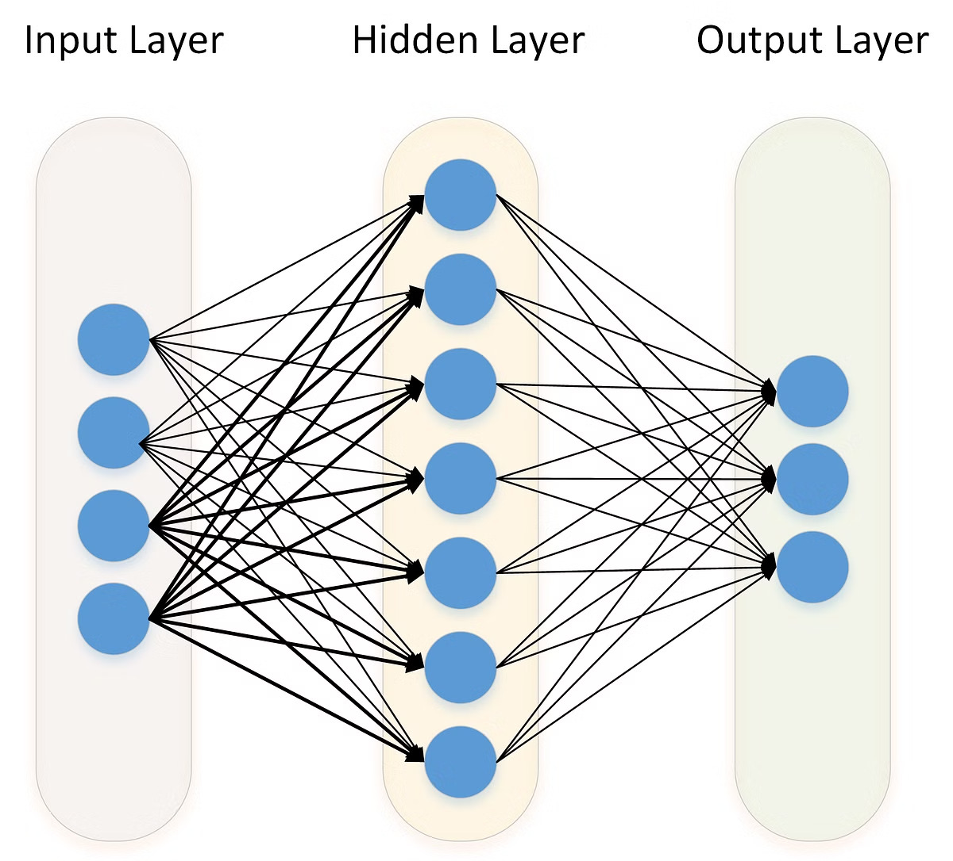
Deep Learning and Neural Networks
Input Layer
Receives the initial data to be processed by the neural network.
1
Hidden Layers
Perform feature extraction and transformation to identify patterns in the data.
2
Output Layer
Generates the final predictions or classifications based on the learned features.
3

Slide 8

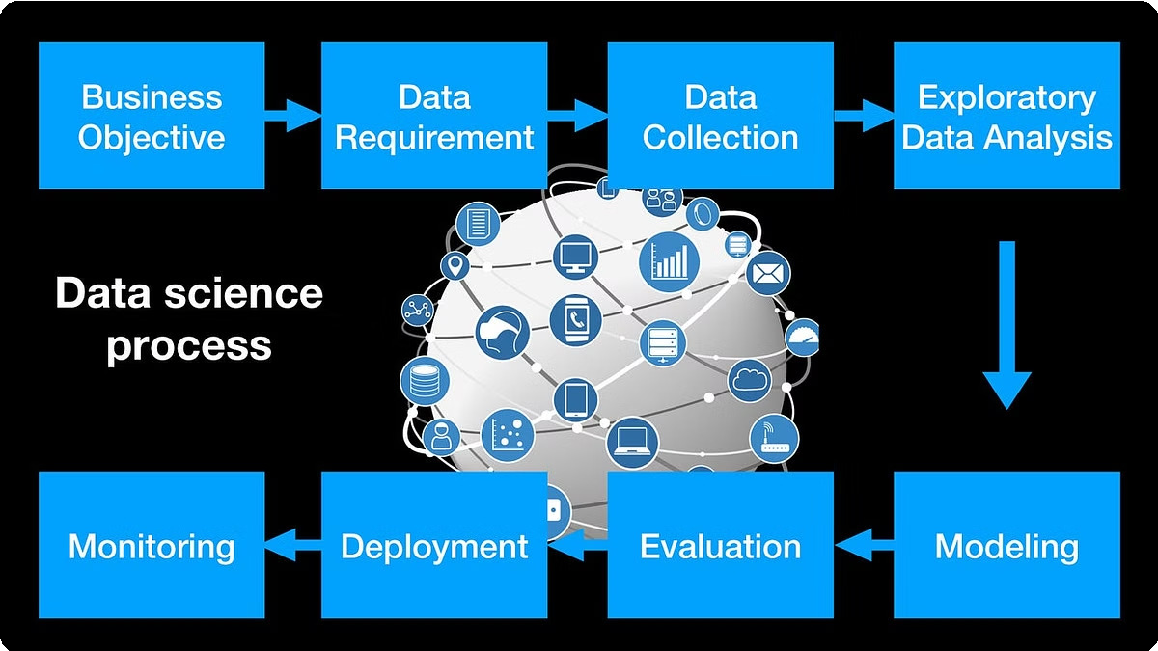
Real-World Applications of Data Science
1
Predictive Maintenance
Using sensor data and machine learning to predict equipment failures and schedule maintenance.
2
Customer Segmentation
Analyzing customer behavior and demographics to create targeted marketing strategies.
3
Fraud Detection
Identifying fraudulent patterns and anomalies in financial transactions and data.
4
Personalized Recommendations
Providing personalized product or content recommendations based on user preferences and behaviors.

Slide 9

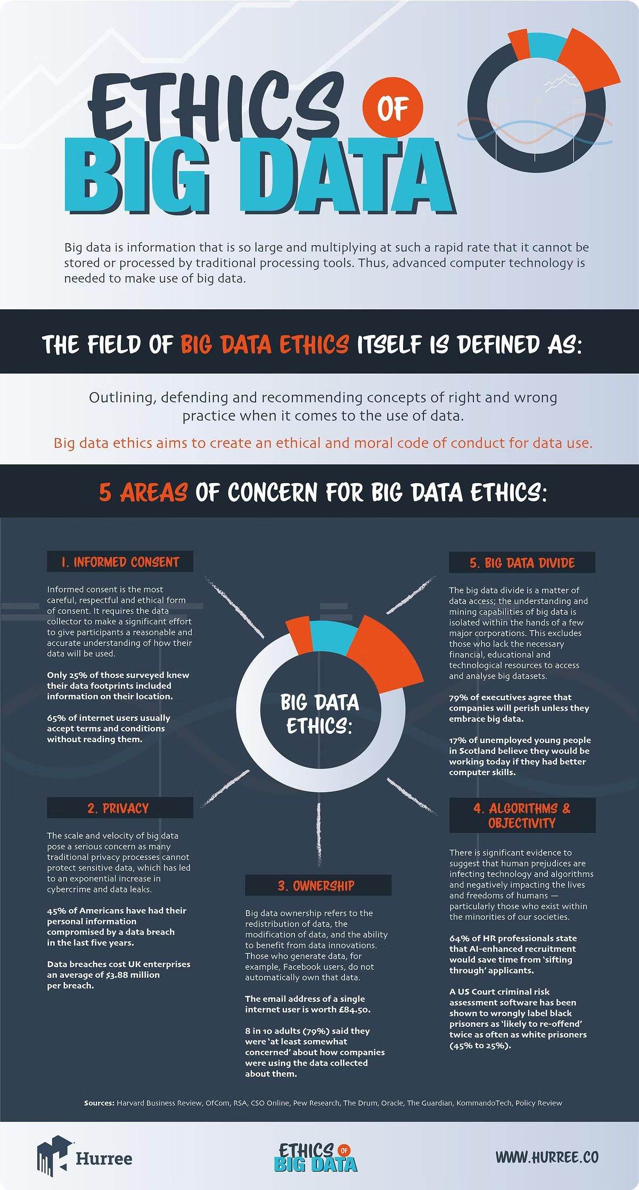
Ethical Considerations in Data Science
Privacy
Ensuring the protection of personal and sensitive data.
Bias
Addressing and mitigating algorithmic bias that can lead to unfair decisions.
Transparency
Providing clear explanations of how data-driven models and decisions are made.
Accountability
Establishing responsible data governance and oversight to prevent misuse.

Slide 10
The Future of Data Science
As technology continues to evolve, the field of data science will become increasingly advanced and influential. Emerging trends include the integration of artificial intelligence, the rise of edge computing, and the growing importance of ethical data practices.

Slide 11
THANK YOU

